Slide 1
BTech Final Project Presentation A.Y. 2022-2023 Project Title: Image Tampering Detection
Presented by : Vardhaman Munot B033, Aniket Dubey B064, Jash Shah B072, Prince Tibadia B079
Under the guidance of : Prof. Supriya Agarwal

Slide 2
Introduction
People tend to believe what they can see, and this affects their judgment, which leads to a series of unwanted responses. Because fabrications have become widespread, the urgency to detect forgeries has significantly increased.
The goal to devise a method of detecting tampered images using modern AI based technologies namely Error Level Analysis(ELA) and Convolutional Neural Networks(CNN) and protect against fake images and the impact that they may have on unsuspecting users.

Slide 3
Project Scope
To identify a tampered image is a challenging task. Reliability of an image being shared which is tampered is lost. The scope of the project is to develop an application that stores genuine images, protecting users against fake images and the impact that they may have on unsuspecting users.

Slide 4
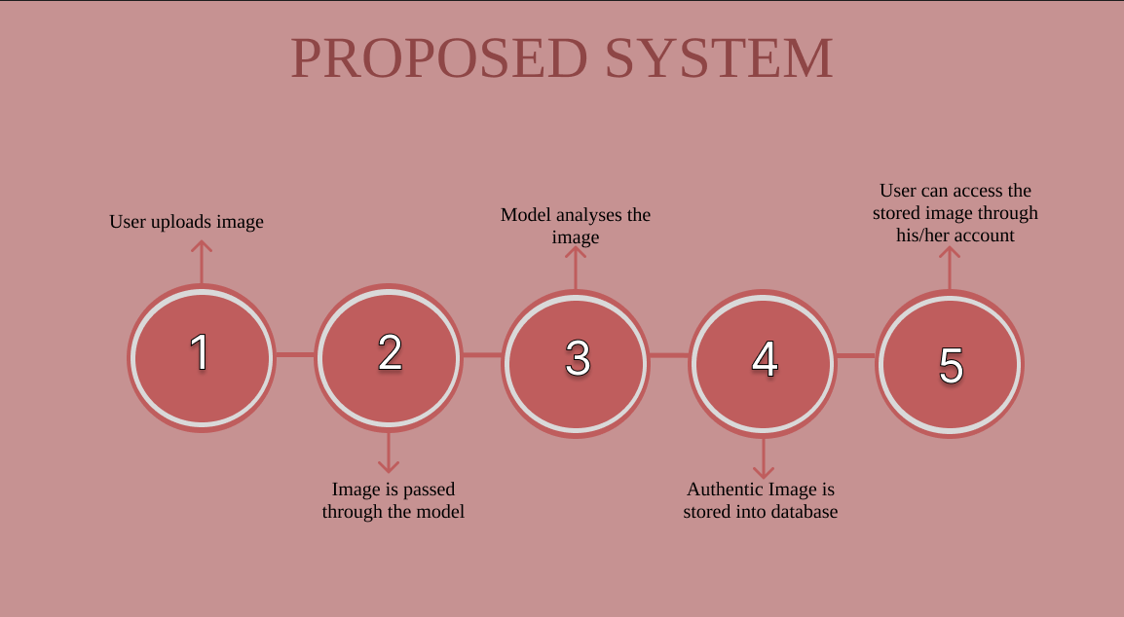
Proposed System

Slide 5
Conclusion
We learned about Error Level Analysis and Convolutional Neural Networks
Developed a WebApp to integrate with the CNN Model
Model showed high accuracy while detecting tampered images even on unseen tampered images

